Slide 1
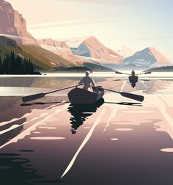

Art Style Board
V-Oar
Notes:
*This presentation has been created for discussion purposes only, and for the ability to visually demonstrate what otherwise would be rather difficult and time consuming to describe. It is NOT the final decision on the design and art style of the project.*

Slide 2
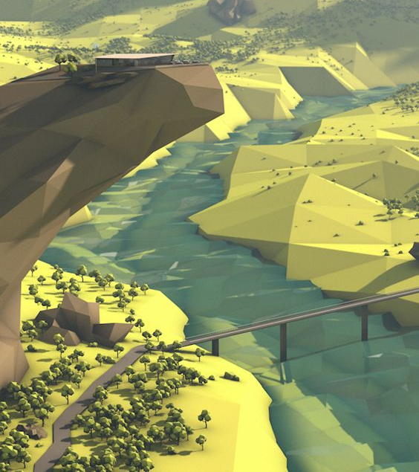
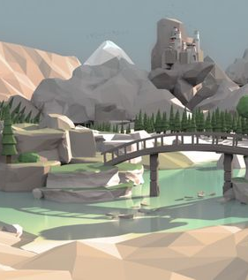
Low Poly
The Landscape Structure

Slide 3
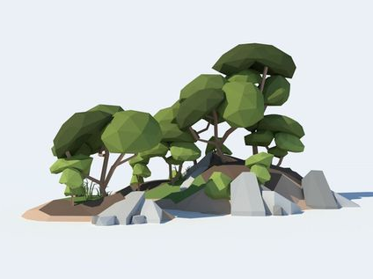
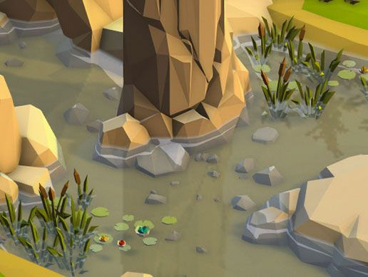
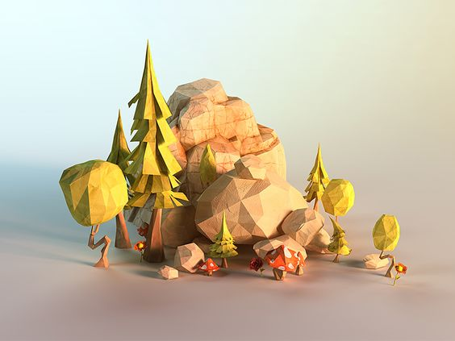

Slide 4
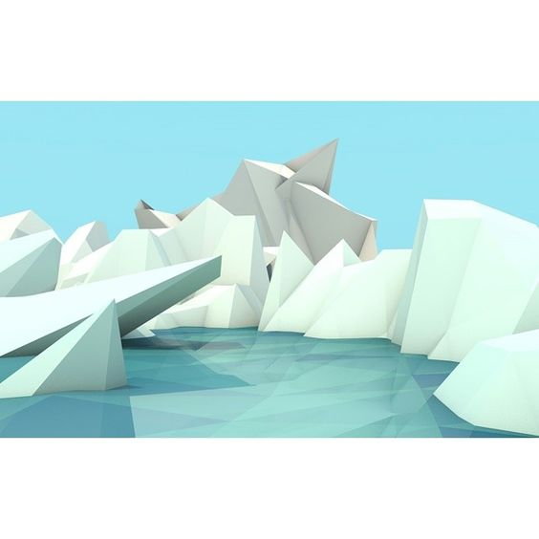
Water
Low Poly
Notes:
Water Poly could probably prove to be time consuming to achieve, later on Cartoonified water will be mentioned as a possible substitute alongside a few game references, some of which provide with very visually pleasing approaches to handling water.

Slide 5
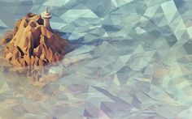
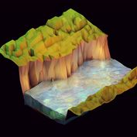
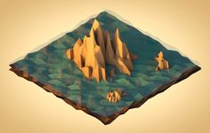
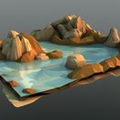

Slide 6
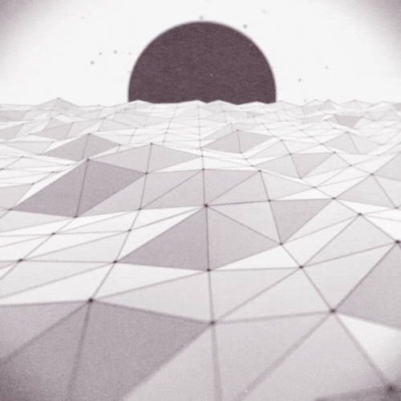
Movement of the polygon water

Slide 7
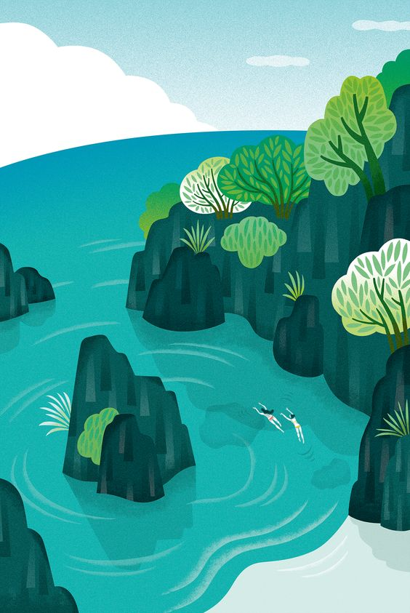
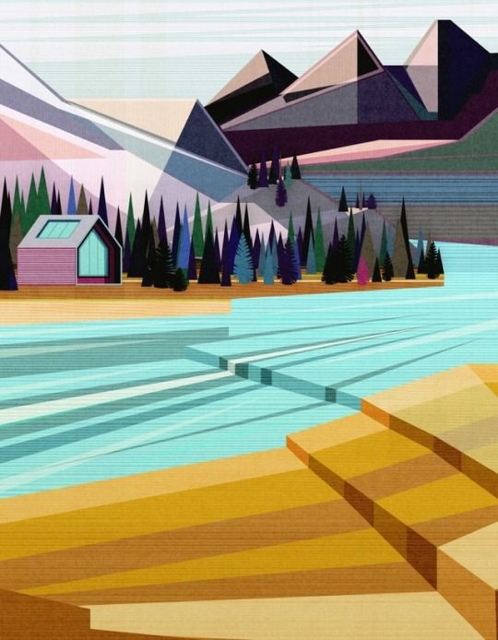
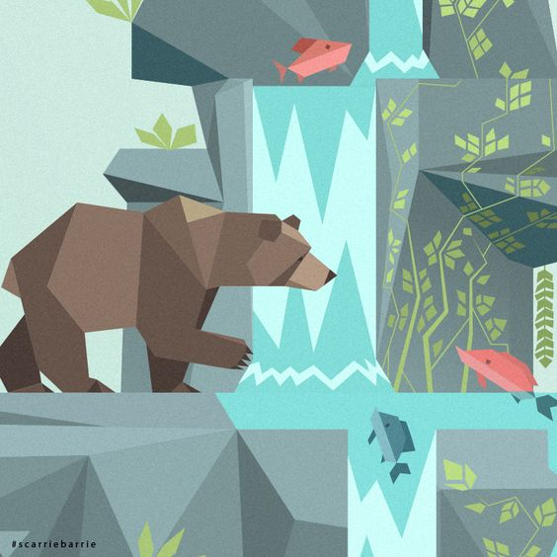
Water
Cartoon Style

Slide 8
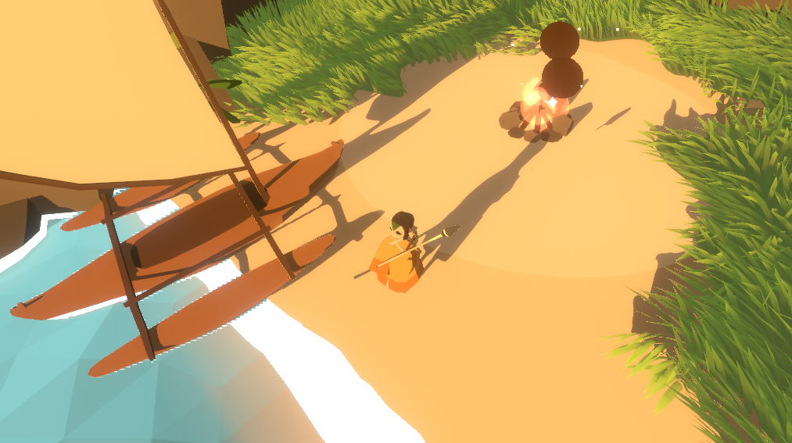
Art Style
The Beauty of Minimalism
Cover Image Credit: The Cocoknight by Rad Magpie

Slide 9
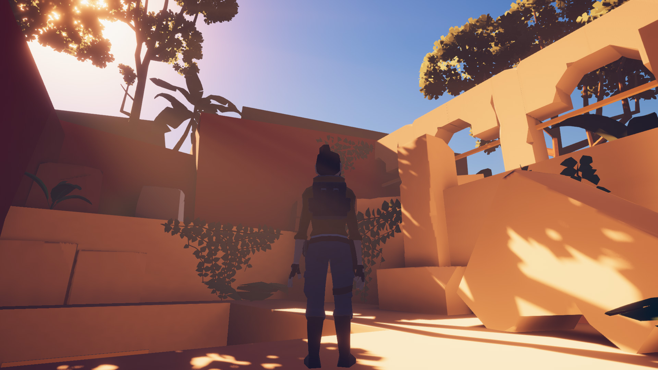
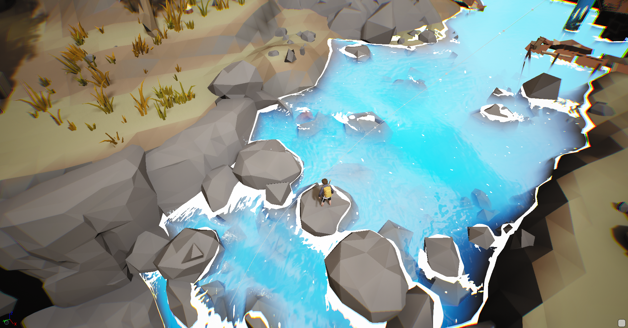
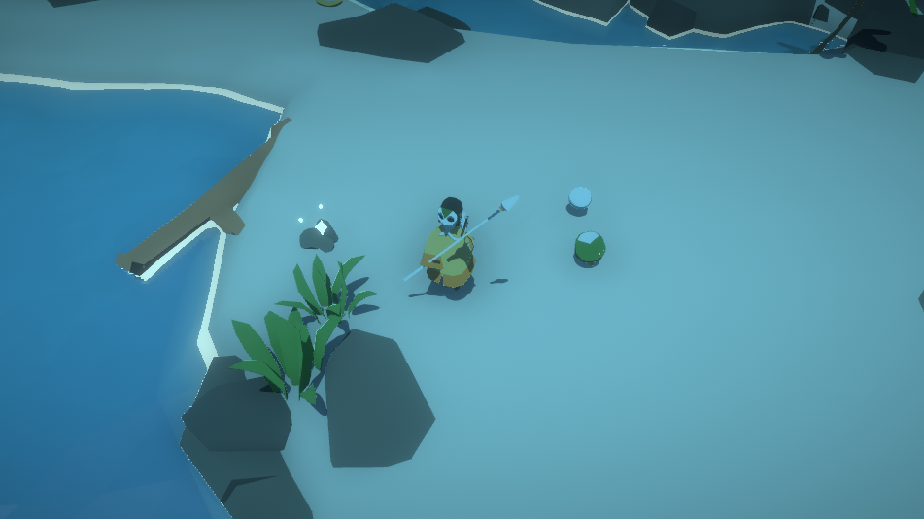
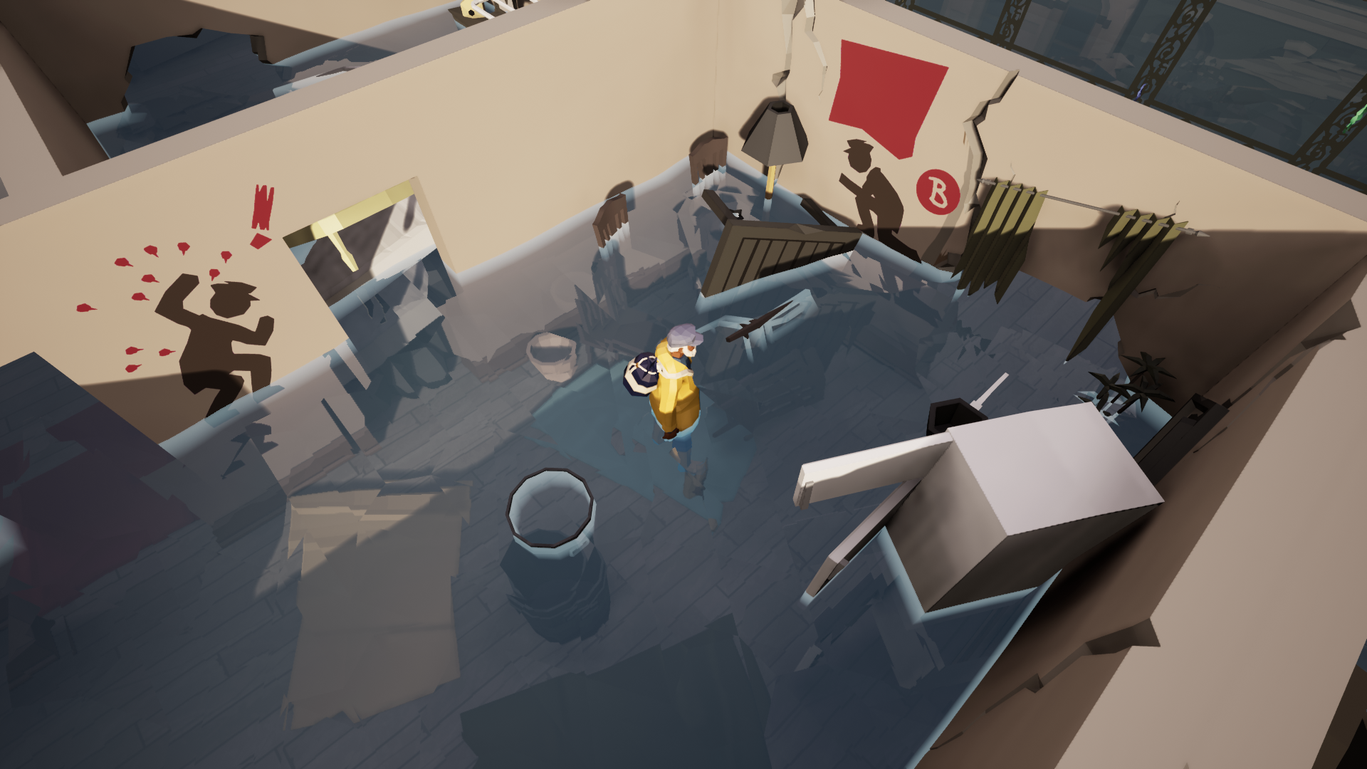
The Adventure of Ben and Spike (pistolizedcannon)
Base Colours and Shades over Textures
Developing a good colour scheme, shades, particle and lighting effects
Considering High Contrast Colours in environment (e.g. dull coloured environment with a stronger emphasis on reds in various areas)
Minimal Raider (hedgefield)
Lost in Tide (ArtFX School)
Cocoknight (Rad Magpie)
Notes:
The Adventure of Ben and Spike has visually appealing water. Containing a nice touch of white foam, which could be used to indicate water movement and shallow waters (where there is more of it congregated in one area).

Slide 10
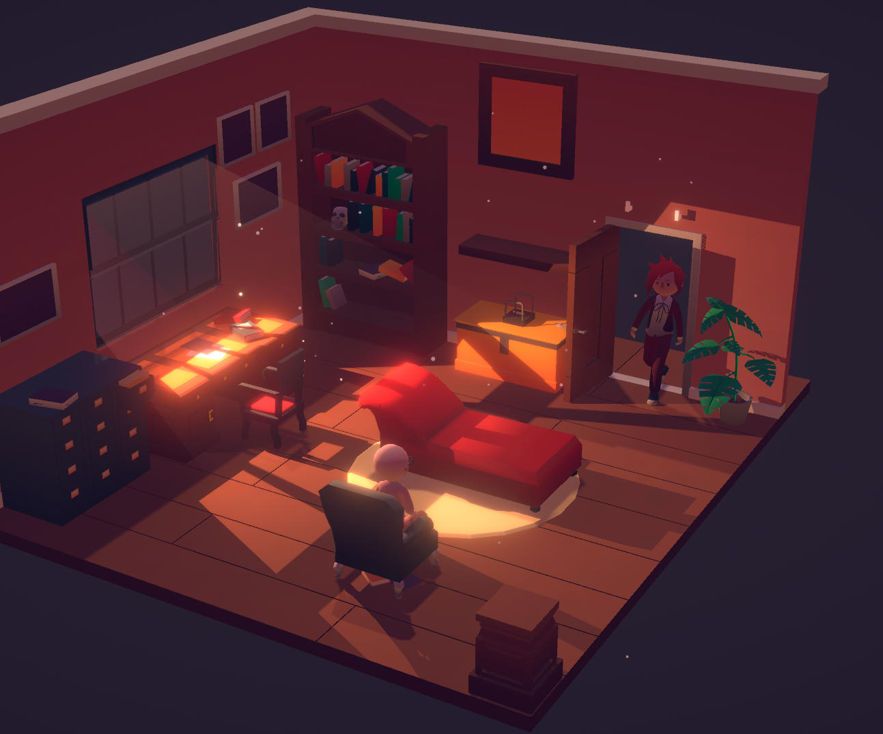
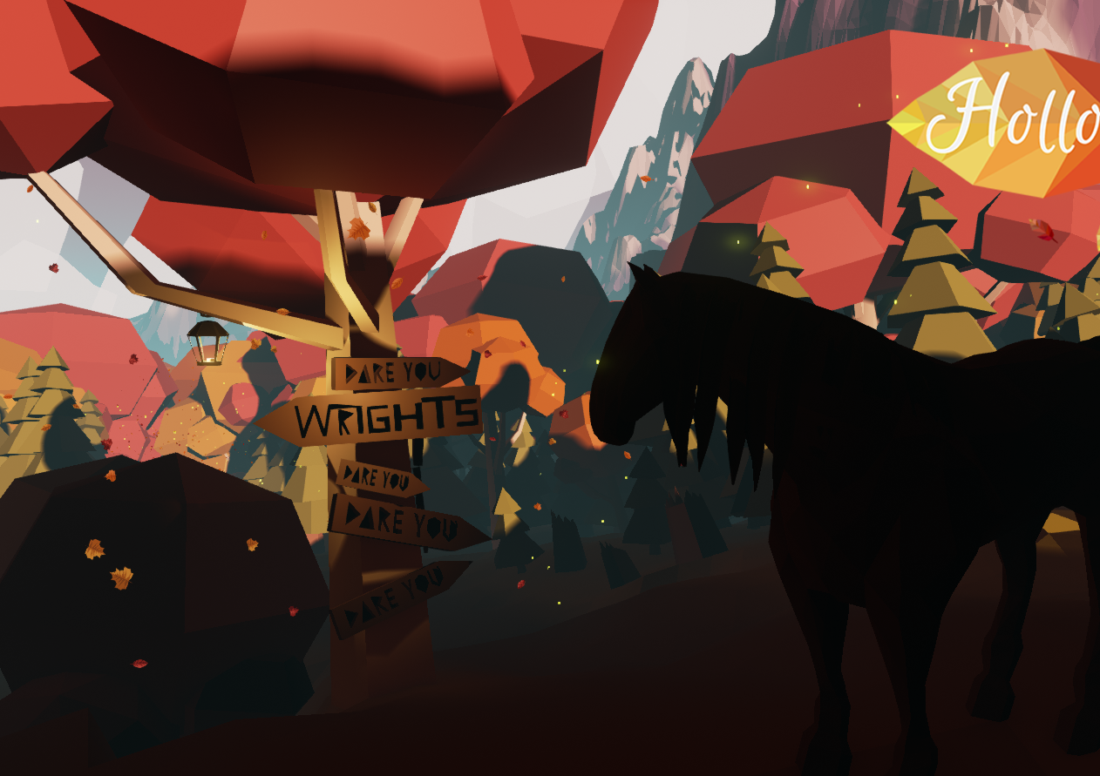
[Dr Emoji] is a good example of how professional and warm an environment can be, when lighting is applied well.
While Hollow, contains beautiful, vibrant and warm colours, but it’s downfall is poor lighting implementation, causing disorientation.
[Dr Emoji] (Vainary)
Hollow (Cherry Pie Games)

Slide 11
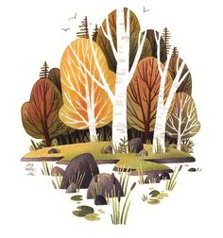
Colours and Overall Atmosphere

Slide 12
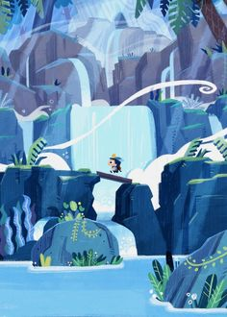
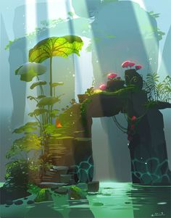
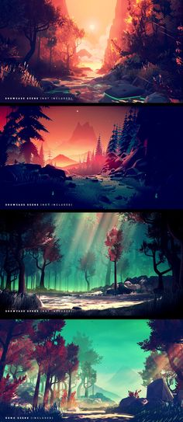
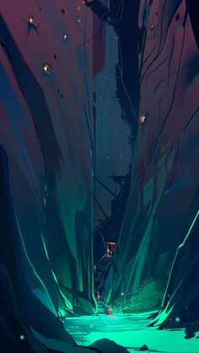
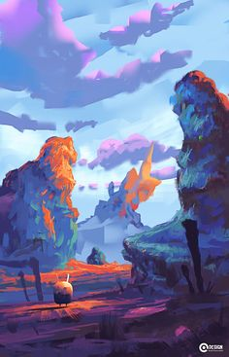
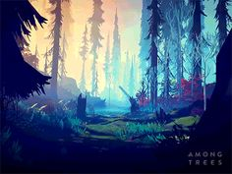
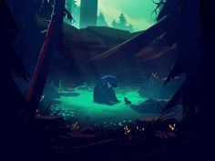
“New Orleans Nightscape”
Giving that warm, sunset type swamp theme.

Slide 13
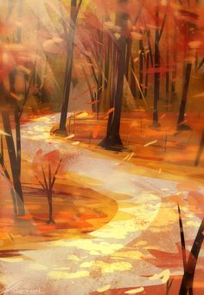
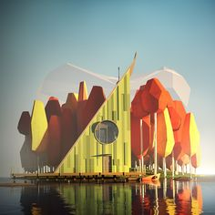
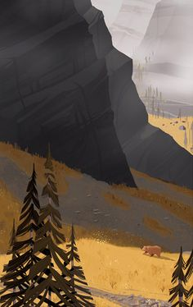
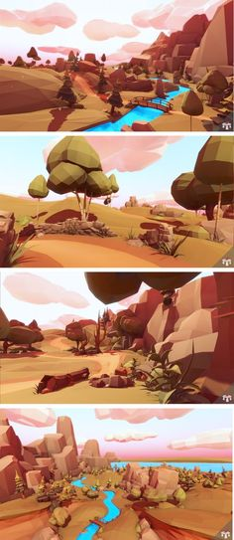
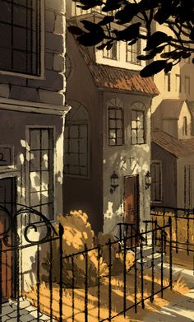
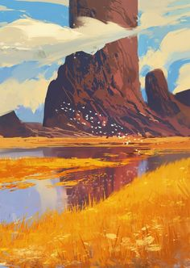
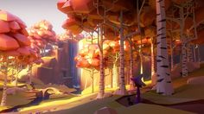
“Warm Summer”
Focusing on a relaxing, warm and cosy palette, the one you don’t find in Ireland…

Slide 14
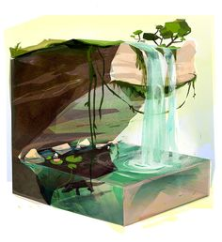
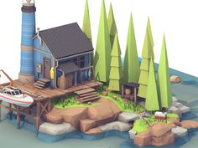
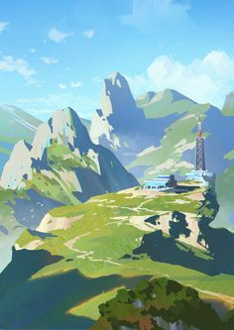
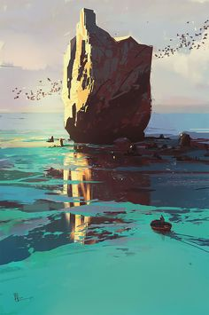
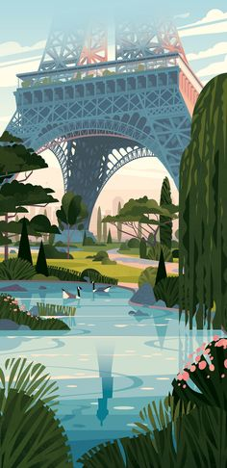
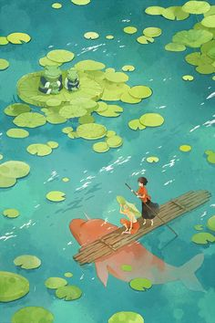
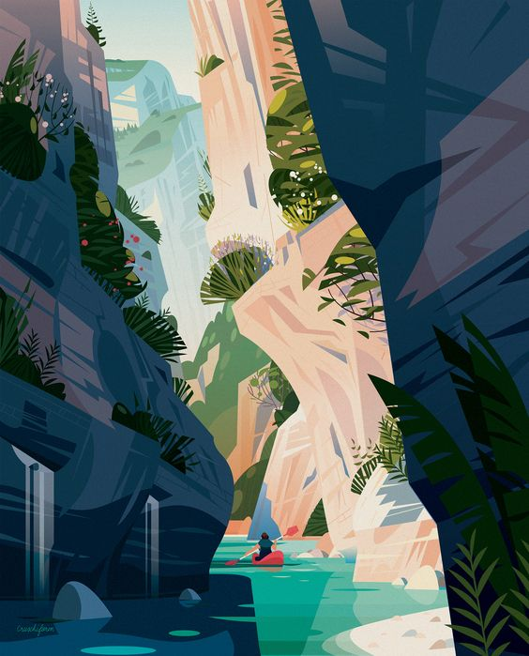
“Tropical”
More mild and Spring like colours.
Personally think this is the most typical palette to use for a water sport related game.

Slide 15
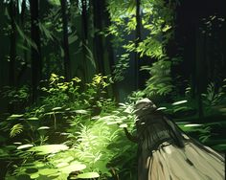
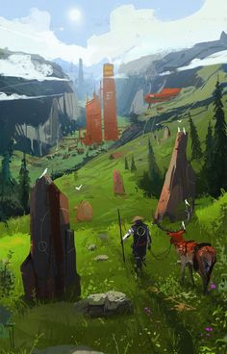
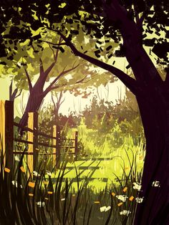
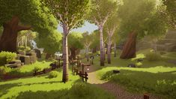
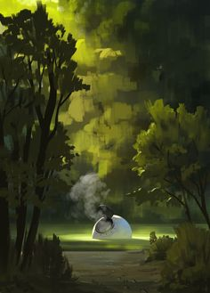
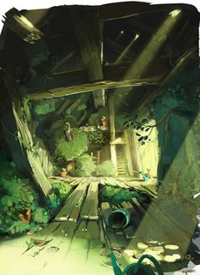


“The Woods ”
Coupling with the water that will have to be included, this would be very similar to the “Tropical” palette.
However, this palette should consist of a greater amount of greens, mostly focusing on more heavier shades and brown earthly colours.

Slide 16


The Environment

Slide 17






Large structures to row under
Cliffs, Arches, Stacks, Caves, Skerries and Waterfalls
Stacks in the water, to provide things to swim around.
Layout similar to the water level seen in “Lara Croft Legends” (just before the entrance to the cave where her colleague got stuck and left behind in, years ago).
Small lakeside structures near lake OR on island in the middle of lake
Some thin, tall trees growing out of water to serve as obstacles

Slide 18

User Interface

Slide 19




UI in game for pause menu, could consist of electronic watch type of structure
Fog Effect atop the electronic watch could be applied onto the UI (If the game has cold or rainy weather, or after swimming through waterfall/ capsizing)

Slide 20


3D Model Design

Slide 21





Slide 22







Slide 23
Referenced Games Library: https://itch.io/c/1176836/teams-visual-design-ideas Pinterest Board for Images used: https://www.pinterest.ie/kris98saroka/gd4-teams-moodboard/
Links

